Slide 1
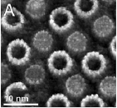

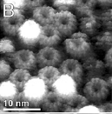
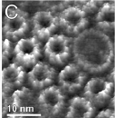
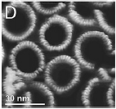
Cantilever-based microscopy in biophysics
Clementine Fournier
November 15, 2016
Image Credit: Muller et al. (2008)

Slide 2
Outline
Cantilever-based microscopy in biophysics
I. Operating principles of an Atomic Force Microscope (AFM)
II. Two possible uses: high resolution imaging and nano-force testing
III. Applications in biophysics
2

Slide 3
Outline
Cantilever-based microscopy in biophysics
I. Operating principles of an Atomic Force Microscope (AFM)
II. Two possible uses: high resolution imaging and nano-force testing
III. Applications in biophysics
3

Slide 4
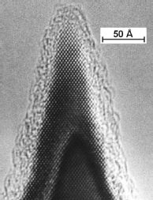
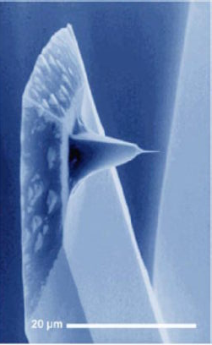
Operating principles of an Atomic Force Microscope (AFM)
How does an AFM work?
Image Credit: Department of Materials, ETH Zurich
Image Credit: Physics Department, Warwick University
4

Slide 5
Operating principles of an Atomic Force Microscope (AFM)
How does an AFM work?
Operating principle? Interaction between the atom on the edge of the tip and the sample’s atoms
Signal measured? Deflection of the cantilever upon tip-sample interaction
Force resolution? A few piconewtons
Operating conditions? In air or liquid environments
At every temperature around ambient
5

Slide 6
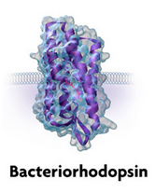
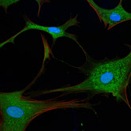
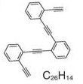
Operating principles of an Atomic Force Microscope (AFM)
What kind of samples for this technique?
AFM = Ideal for in vitro biological applications
Samples range from single molecule to entire cell
Image Credit: De Oteyza et al. (2013)
Image Credit: Princeton University, Sarah Pfau
Image Credit: Fairman studio LLC
6

Slide 7
Outline
Cantilever-based microscopy in biophysics
I. Operating principles of an Atomic Force Microscope (AFM)
II. Two possible uses: high resolution imaging and nano-force testing
III. Applications in biophysics
7

Slide 8
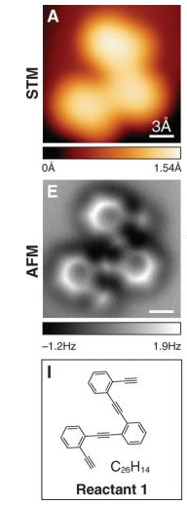
Two possible uses: high resolution imaging and nano-force testing
High resolution imaging
AFM: topography recorder
Result: 3D mapping of a sample
and height profile
Resolution: nano-scale
more recently angstrom-scale
Image Credit:
De Oteyza et al.
(2013)
Image Credit:
Muller et al.
(2007)
8

Slide 9
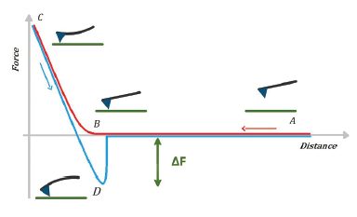
Two possible uses: high resolution imaging and nano-force testing
Force spectroscopy
AFM: nanomechanical tester
Possible applications:
Friction measurement, micro-
lithography, acquisition of
force-distance curves.
Example: Vinckier, Semenza (1998)
Young’s modulus calculation for cells
or microtubules.
Image Credit: Galajda et al. (2015)
9

Slide 10
Outline
Cantilever-based microscopy in biophysics
I. Operating principles of an Atomic Force Microscope (AFM)
II. Two possible uses: high resolution imaging and nano-force testing
III. Applications in biophysics
10

Slide 11
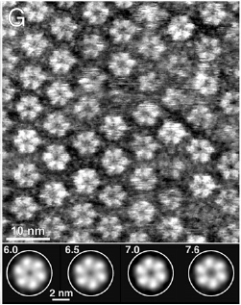
Applications in biophysics
From single molecules to cells mapping
One example : Muller et al. (2008)
Observation of native membrane proteins at work
Picture: Communication channels from rat liver cells. Gap junctions closing due to pH change.
Image Credit: Muller et al. (2007)
11

Slide 12
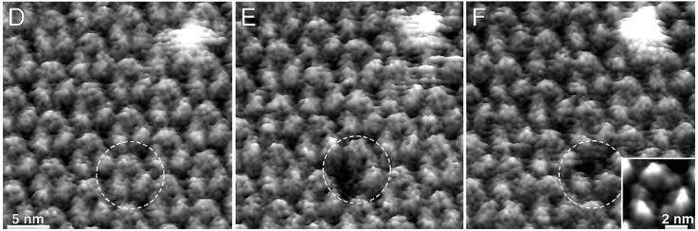
Applications in biophysics
From single molecules to cells mapping
Another example: Light-driven proton pump bacteriorhodopsin (BR)
Removal of one BR : global rearrangements
Image Credit: Muller et al. (2007)
12

Slide 13
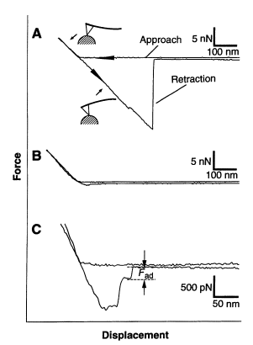
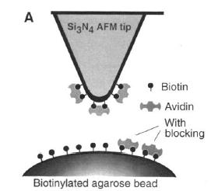
Applications in biophysics
Using bio-recognition
Cantilever-based biosensors
Receptor-ligand binding tester
Example: Florin et al. (1994)
Finding the receptor-ligand unbinding force between biotin and avidin using a force-displacement curve
Image Credit: Florin et al. (1994)
13

Slide 14
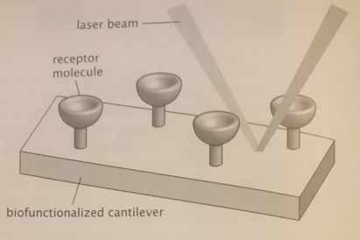
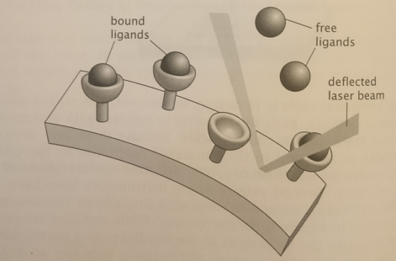
Applications in biophysics
Cantilever-based biosensors
Biofunctionalized cantilevers: similar to the AFM. Binding of molecules to the surface alters the surface free energy
Ligands
Image Credit: Phillips et al., Physical biology of the cell, Garland Science
14

Slide 15
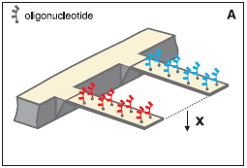
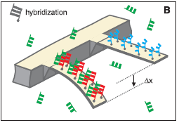
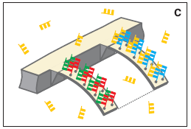
Applications in biophysics
Cantilever-based biosensors
Example : Fritz et al. (2000) Monitoring single strand DNA hybridization with two microcantilevers in parallel
System able to detect a single base mismatch
Image Credit: Fritz et al. (2000)
15

Slide 16
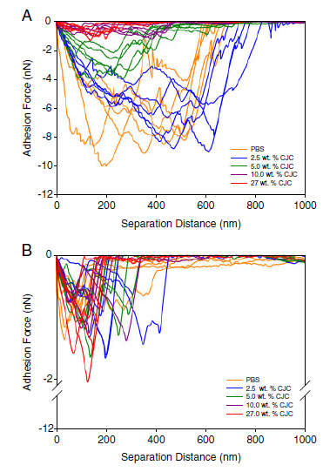
Applications in biophysics
But also…
Cellular biomechanics
Cell-cell interactions
…
Image Credit: Liu et al. (2010)
16

Slide 17
References
De Oteyza DG, Gorman P, Chen YC, Wickenburg S, Riss A,
Mowbray DJ, Etkin G, Pedramrazi Z, Tsai HZ, Rubio A,
Crommie MF, Fischer FR (2013) Science 340:1434-1437.
Muller DJ, Engel A, (2007) Curr Opin Colloid Interface Sci
Vinckier A, Semenza G (1998) FEBS Lett 430:12-16.
Florin EL, Moy VT, Gaub HE (1994). Science 264:415-
417.
J. Fritz, M.K. Baller, H.P. Lang, H. Rothuizen, P. Vettiger, E.
Meyer, H.-J. Güntherodt, C. Gerber, J.K. Gimzewski, (2000)
Science 288 316–318.
Liu Y, Pinzon-Arango PA, Gallardo-Moreno AM, Camesano
TA (2010) Mol Nutr Food Res 54:1744-1752.
Image Credit: Muller et al. (2007)

Slide 18
Thank you!
Questions?
Image Credit: Muller et al. (2007)

