Slide 1
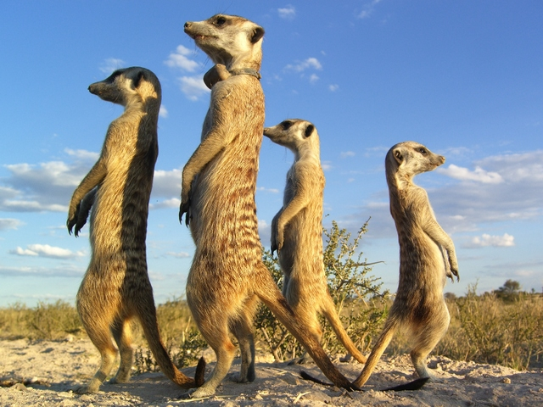
Major Transitions in Evolution
Game Theory
Evolution of Cooperation

Slide 2
The Major Transitions in Evolution
Book by John Maynard Smith and Eors Szathmary (1995)
The increase in complexity of organisms over time has depended on a small number of major transitions in the way genetic information is transmitted.
Caveat - How do we measure complexity? Number of genes? Number of cell types?
Simple organisms have also survived alongside the complex ones.
They list Eight Major Transitions with the following common features:
1. Integration of lower level units to form a higher level structure. Selection at the higher level has to overcome disruptive selection at the lower level.
2. Division of labour. Different units do different jobs when they used to all do the same job.
3. Change in the language by which information is transmitted
(e.g. RNA → DNA/Proteins, gene regulation and epigenetics, cultural evolution and human language) .
Think how these features apply in the transitions below…

Slide 3
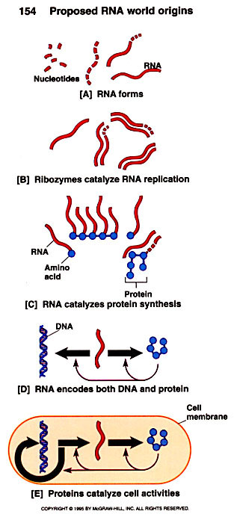
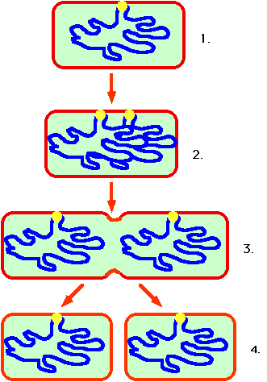
1. Replicating molecules → Populations of molecules in compartments
2. Independent replicators → Chromosomes
3. RNA World → DNA + Protein
Random segregation creates many inviable cells
Bacterial genome replication ensures genes work as a team

Slide 4
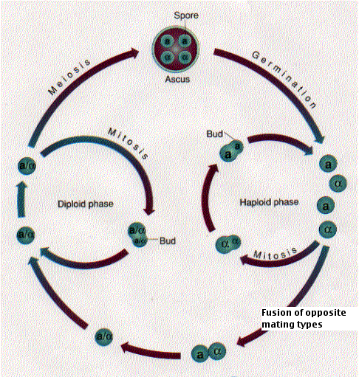
4. Prokaryotes → Eukaryotes
5. Asexual clones → Sexual populations
Yeast has both asexual and sexual stages in the life cycle

Slide 5
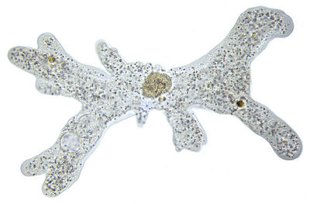
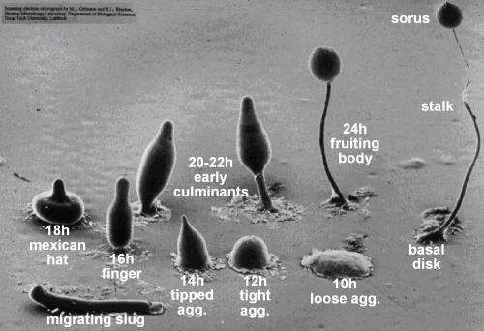
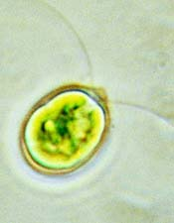
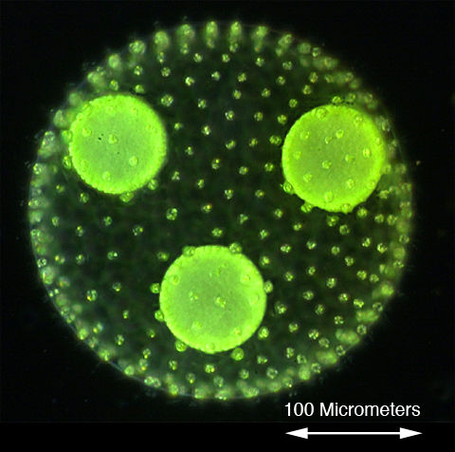
6. Single Cells → Multicellular organisms
Amoeba
Dictyostelium
Chlamydomonas
Volvox

Slide 6
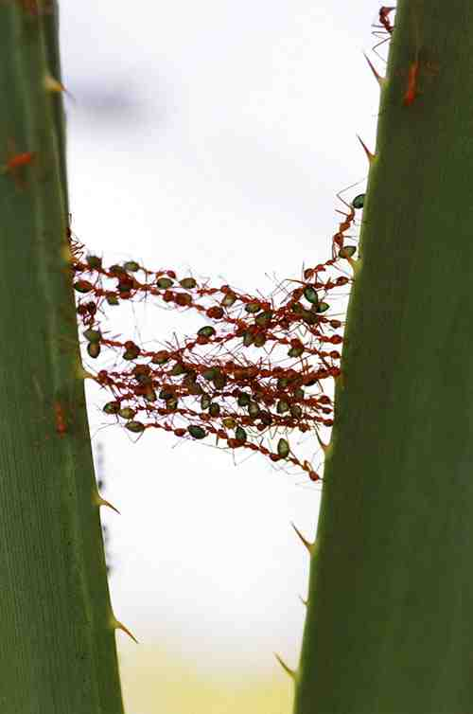
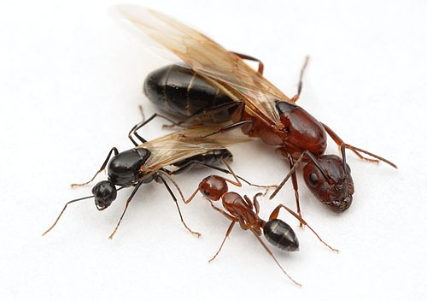
7. Solitary individuals → Colonies (non reproductive castes)
Queen, male and worker ants
Cooperation in an ant colony

Slide 7
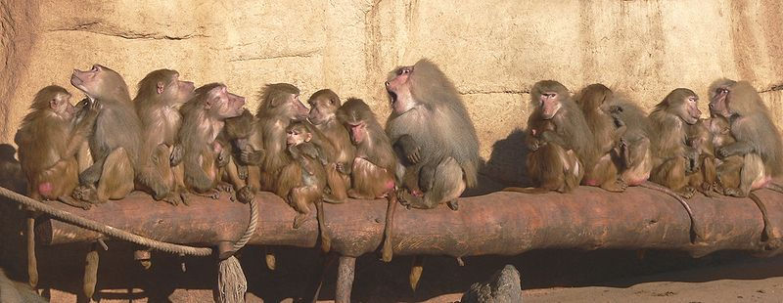
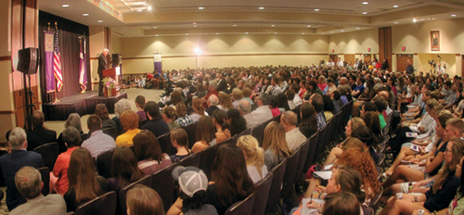
8. Primate societies → Human societies

Slide 8
Evolutionary Game Theory – The Hawk-Dove Game
Aggressive behaviour in animals is often reduced to displays and bluff.
V = value of resource (food, territory, mate)
C = cost of fight (injury, time, energy)
You
 | H | D
H | (V-C)/2 | V
D | 0 | V/2
Matrix shows payoff to Me
Me
What would you do?
The essential point of game theory models is that the payoff (or fitness) of your strategy depends on what the other players do too.

Slide 9
In Economics – A Nash Equilibrium is rational choice of strategies such that no player can benefit from changing their strategy while the others keep their strategy fixed.
In Biology – An Evolutionarily Stable Strategy (ESS) is one that cannot be invaded by any other strategy. The fitness of any individual playing another strategy is lower than the individuals playing the ESS. The population therefore evolves towards the ESS.
If V > C
It is always best to be H whatever the opponent does
H is an ESS
If the population plays H, a D always does worse. D cannot invade.
If the population plays D, an H does better. H can invade D.
Population evolves towards all H.
If V < C
Best to be H if opponent is D, and best to be D if opponent is H.
Population evolves towards a mixture with a fraction V/C of H.
At this point both H and D have equal payoff.

Slide 10
If V < C the ESS is a mixed strategy.
If strategies are fixed, we expect a genetic polymorphism with two types of behaviour controlled by two types of genes.
e.g. Fig wasps – Jawed males = H, Winged males = D
If strategies are probabilistic (choice of behaviour) each individual should play both strategies randomly with probabilities p_{H} = V/C, p_{D} = 1 – V/C.
Note that the ESS does not usually optimize the mean fitness of the population.
e.g. if V > C, H is the ESS, therefore everyone has fitness (V-C)/2,
But if everyone were D, they would have fitness V/2.
H can invade D because the fitness of a single H in a population of Ds is V, which is higher than the fitness of the Ds (only V/2).
In this example short term selection on the individual beats group selection, and the group ends up worse off.

Slide 11
Mathematical treatment of Game Theory
p_{i} = frequency of strategy i
g_{ij} = payoff of strategy i against j
Mean payoff of strategy i
Mean payoff of whole population
Deterministic evolutionary dynamics
Frequency of i goes up if
At the ESS the fitness of all the surviving strategies =

Slide 12
ESS conditions
i is the dominant strategy, j is the invader
Let p_{j} = ε, and p_{i} = 1-ε
G_{i} = (1-ε)g_{ii} + εg_{ij}
G_{j} = (1-ε)g_{ji} + εg_{jj}
Strategy j can invade i if G_{j} > G_{i}
i.e. if g_{ji} > g_{ii}
or g_{ji} = g_{ii} and g_{jj} > g_{ij}
Strategy i is an ESS if there is no j that can invade.
i.e. if for all j, either g_{ii} > g_{ji}
or g_{ii} = g_{ji} and g_{ij} > g_{jj}

Slide 13
Bourgeois game – deals with asymmetrical contests (e.g. prior ownership)
Each player is assumed to be owner half the time and intruder half the time.
Three strategies: H, D and B.
B behaves like H if he is the owner and like D if he is the intruder.
If V > C, H is the ESS
Same as before.
If V < C, B is the ESS.
This means that the asymmetry is used to settle all the conflicts without a cost. The result is that there are no fights (looks like all D), and the mean fitness is equal to V/2.

Slide 14
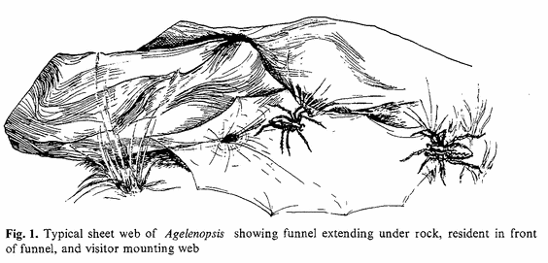
Riechert (1978)
“Games spiders play”
Fights between a web owner and an intruder.
Scale of aggression and duration of fights were quantified.
Fights were longer and more aggressive when good sites were rare.
Asymmetries affect outcome.
- Owner more likely to win (Bourgeois).
- Larger individual more likely to win.
3. Contests were longer if individuals were of similar size.
4. Longest contests were when the owner was slightly smaller than the intruder.

Slide 15
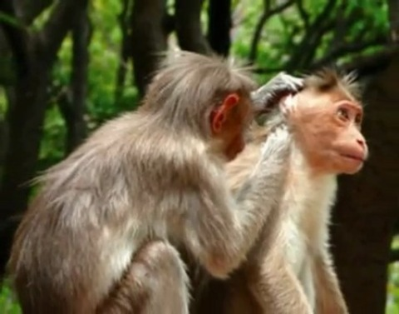
The Prisoners’ Dilemma – Archetypal model for Evolution of Cooperation
C = cooperate
D = defect (or cheat)
Stories - Prisoners; Superpowers; Grooming....
You
 | C | D
C | R | S
D | T | P
Me
Matrix shows payoff to Me
T (temptation) > R (reward) > P (punishment) > S (sucker)
What would you do?
Logic says always defect. D is an ESS

Slide 16
The Iterated Prisoners Dilemma – Axelrod’s Tournaments
Play many rounds. Probability x of stopping after each round.
Number of rounds unknown. Mean number of rounds = 1/x.
Individuals specified strategies and enetered them in a tournament.
Each strategy played every other and a copy of itself. Points were totalled.
Winner was Tit-for-Tat = Play C first time and then do what the opponent did last time.
A TFT continues to cooperate with a C or another TFT, but it retaliates against a D.
A TFT is not a sucker and it can’t be invaded by D.
In the iterated game, the expectation of future payoff is enough to promote cooperation. It is important that the end of the game is not known, otherwise you would always defect on the last round (and eventually on all the rounds).
TFT tends to switch to D if errors are made.
Could not prove ESS in this case because the rules were not sufficiently defined.

Slide 17
Stochastic Strategies in the Iterated Prisoner’s Dilemma
Nowak and Sigmund, Nature (1992)
You
 | C | D
C | 3 | 0
D | 5 | 1
Memory 1 strategies:
p = prob to play C if opponent played C last time
q = prob to play C if opponent played D last time
Me
1
(1,1) = always C
q
(p,q) = general strategy
(1,1/3) = generous TFT
(0,0) = always D
0
(1,0) = TFT
0
1
p

Slide 18
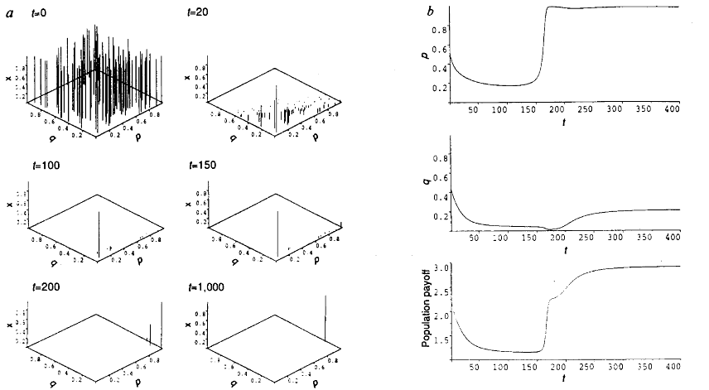
Begin with 100 random strategies and run deterministic evolutionary dynamics
(birth rate proportional to payoff).
Defectors win initially until suckers run low.
TFT invades all-D
GTFT invades TFT – stability is reached.
Can prove GTFT is an ESS in this model.
Population fitness is maximized by GTFT and cooperation is insured.

Slide 19
In the case above, the strategy next round depended only on what the other player did last time.
Nowak and Sigmund (Nature 1993) extended this to cases where the strategy can depend on what both players did last time.
Outcome last time (R, S, T, P) → prob of cooperating this time (p₁, p₂, p₃, p₄)
TFT is (1, 0, 1, 0)
GTFT is (1, 1/3, 1, 1/3)
Showed that another strategy Pavlov (1, 0, 0, 1) usually evolves in this case.
Pavlov is a ‘reflex’ strategy that carries on doing the same thing if it did well last time. It is also called win-stay, lose-shift.
If outcome was R, Pavlov is happy and keeps cooperating.
If outcome was T, Pavlov is happy and keeps defecting.
If outcome was S or P, Pavlov is unhappy and shifts to the other strategy.
Typical simulation:
Random strategies → D → TFT → GTFT → too much C → back to D
or GTFT → Pavlov
Pavlov cannot evolve directly from D. It needs TFT to invade D first.
But Pavlov is more stable once it is formed.

Slide 20
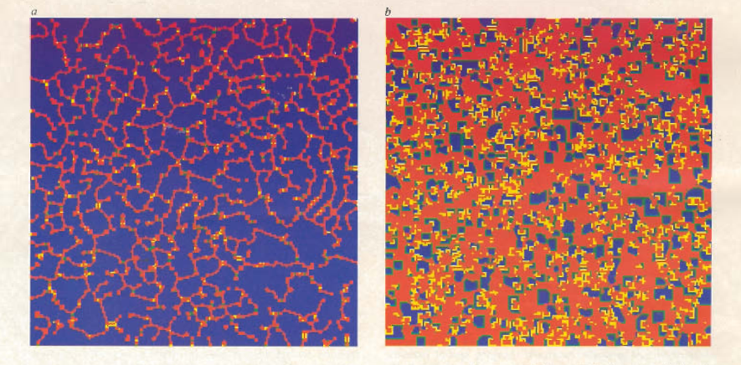
Deterministic spatial prisoners dilemma – Nowak and May, Nature (1992)
 | C | D
C | 1 | 0
D | b | 0
 | X
Each individual plays 8 surrounding sites plus a copy of itself. The central site is occupied by a copy of the strategy that does best of the 9.
Single round prisoners dilemma with strategies C or D only.
Blue = C that was previously C; Green = C that was previously D;
Red = D that was previously D; Yellow = D that was previously C.
Spatial clustering favours evolution of cooperators

Slide 21
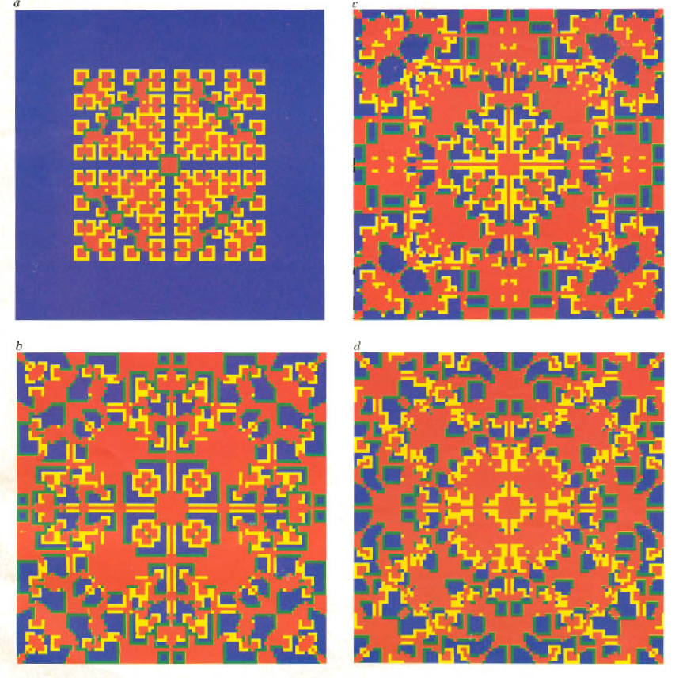
Kaleidoscope patterns produced by a single D beginning in a field of C

Slide 22
Five Rules for the Evolution of Cooperation – Nowak – Science (2006)
Hamilton’s theory of kin selection/inclusive fitness.
It pays to help relatives who have the same genes as you. Genes are selfish but the resulting behaviour is altruistic. Particularly relevant to social insects.
This is the Iterated Prisoner’s Dilemma.
It pays to cooperate because you will see the same guy again soon.
This means that you help someone who you are not likely to see again.
Being nice gets you a good reputation.
People cooperate with others who have a good reputation.
Individuals interact with others who are close in space (lattice model) or in a social network. Clusters of neighbouring cooperators arise that help one another and survive in the presence of defectors. In a well-mixed system, defectors would take over.
Cooperators help members of their own group. Groups with more cooperators grow faster and divide. Groups that are overrun by defectors divide more slowly. Cooperators can survive, whereas defectors would take over in a well-mixed system.

